Slide 1
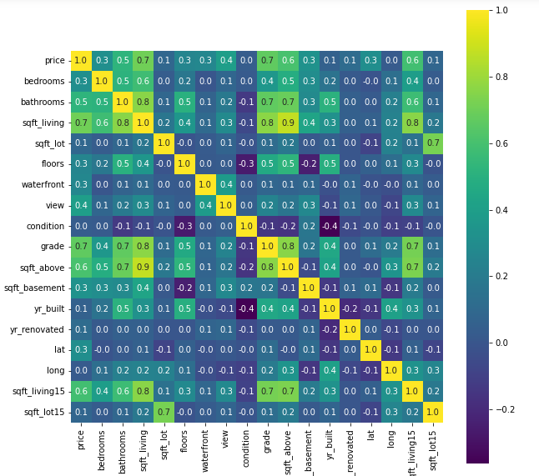
Heat map to show the correlation of features

Slide 2
Correlation observation
Most features in the dataset have a positive correlation with price as it is the target variable

Slide 3
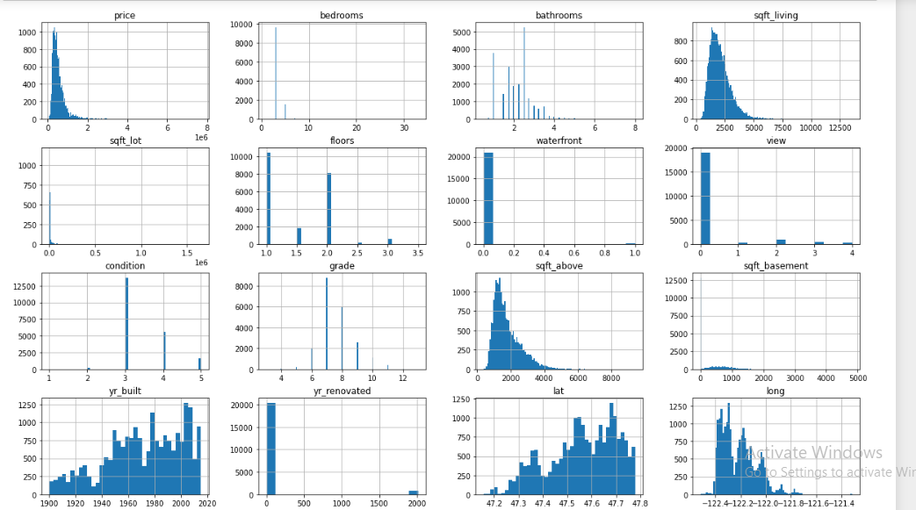
Histogram to show distribution of features in the dataset

Slide 4
Observation
Observations
price, sqft_living, sqft_above, sqft_living which are continuous variables and seem to be normally distributed.
Most houses have one floor, 3 bedrooms, 2 bathrooms, and a condition of 3
The number of houses built seems to increase over time with the 2000's having the most number of houses built.

Slide 5
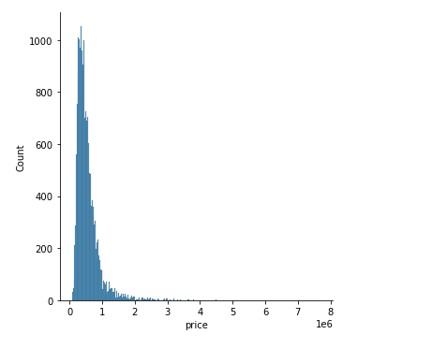
Distplot to show price distribution in the dataset

Slide 6
Observation
The distplot is more skewed to the left meaning that the observations are either small or medium, with a few observations that are larger than the rest.

Slide 7
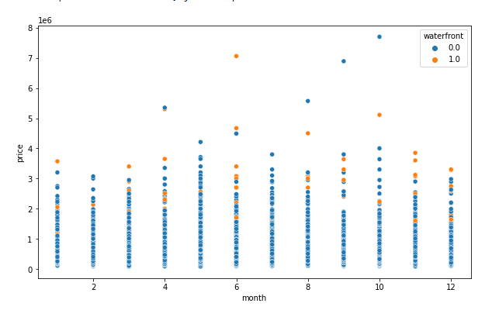
Scatterplot of waterfront against the target variable price and month

Slide 8
Observation
Waterfront properties sold at a higher price as compared to houses without a waterfront.
The most expensive property being sold in June and the least expensive being sold in January
The seasons do not seem to affect the rate at which the houses were sold

Slide 9
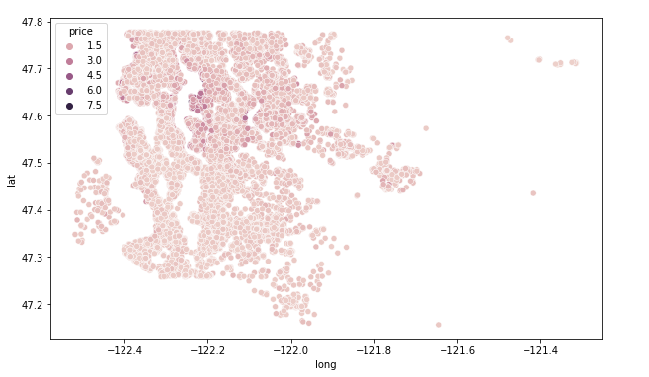
Scatterplot of lat and long against price

Slide 10
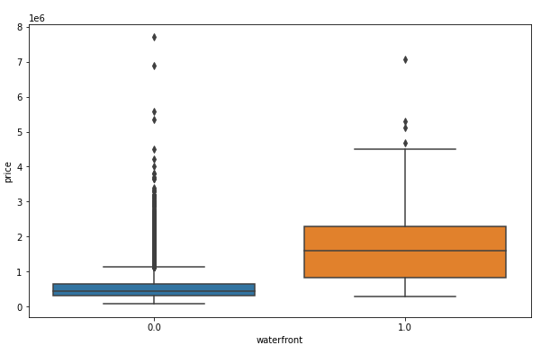
Boxplot to show distribution of waterfront in the dataset against price

Slide 11
Observation
Most areas closer to the water seem to have a higher price compared to the others
Most houses with a waterfront tend be more expensive than those without a waterfront

Slide 12
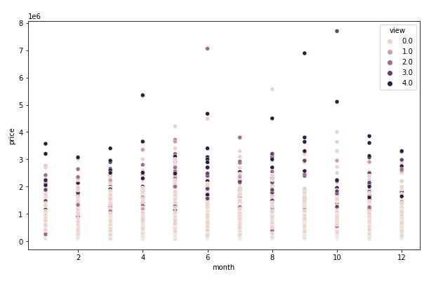
Scatterplot of month against price

Slide 13
Observation
The number of times a house is viewed and how much it sells seems to be even across the months, however we might say that the more the houses were viewed the more they are likely to sell
The most expensive house that had been viewed sold in October
The more a house is viewed seems to have an effect on price

Slide 14
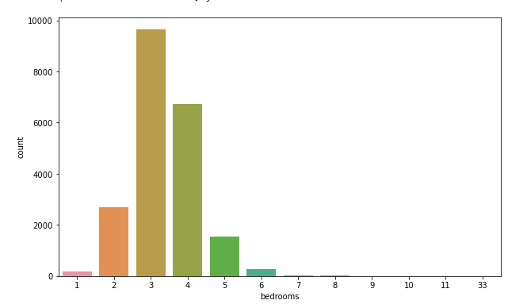
Count plot representing bedrooms in the dataset

Slide 15
Observation
Most houses sold have an average of 3 bedrooms

Slide 16
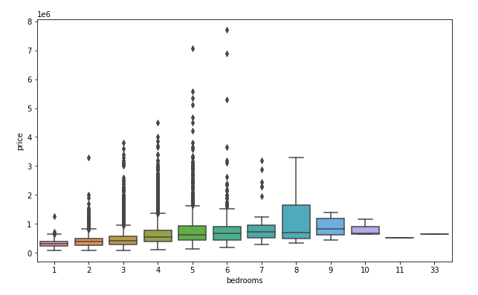
Boxplot to show distribution of bedrooms

Slide 17
Observation
There is presence of outliers, for example the houses with extraordinary number of rooms like the 10,11,33 bedrooms that are way above the bedroom average could be the reason for the high prices

Slide 18
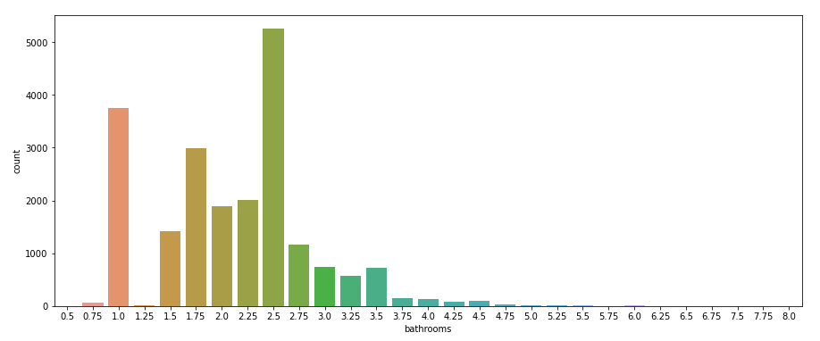
Count plot showing distribution of bathrooms

Slide 19
Observation
Most houses have an average of 2.5 bathrooms

Slide 20
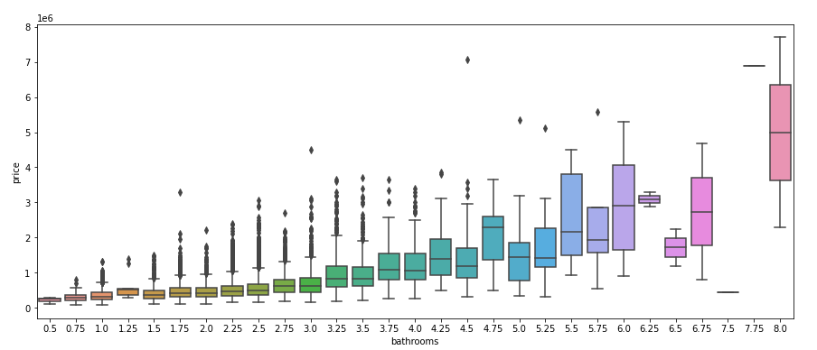
Boxplot showing distribution of bathrooms

Slide 21
Observation
The outliers could be due to the few houses with bathrooms way above or below average

Slide 22
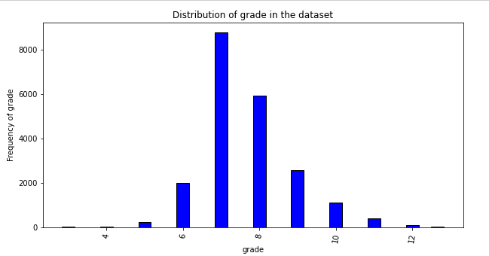
Distribution of grade in the dataset

Slide 23
Oservation
Most houses have a grade of 7

Slide 24
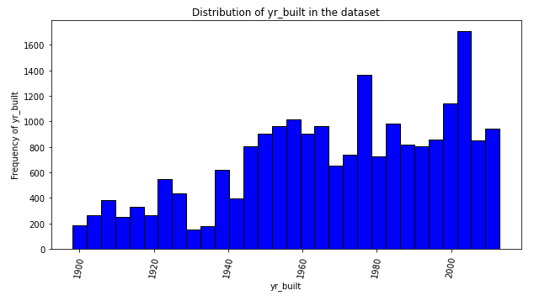
Histogram to show distribution of yr_built

Slide 25
Observation
The number of houses built increases over the years

Slide 26
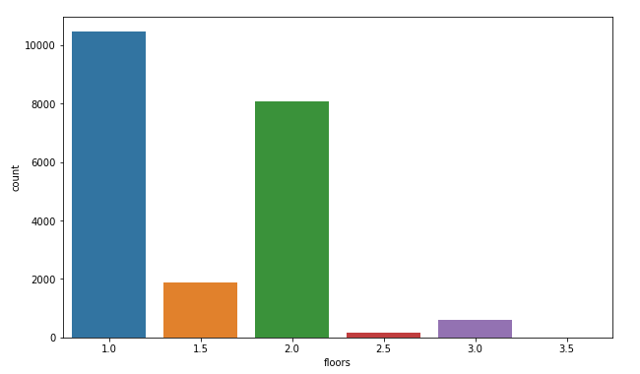
Count plot for the floors in the dataset

Slide 27
observation
Most houses have one or two floors, but majorly just a single floor

Slide 28
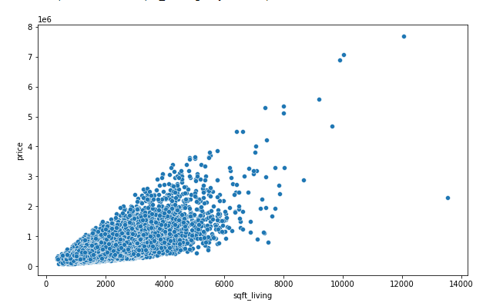
Scatterplot to show distribution of sqft_living against price

Slide 29
Observation
The correlation between sqft_living and price is a strong positive correlation, therefore the more the sqft_living space there is a significant increase in price

Slide 30
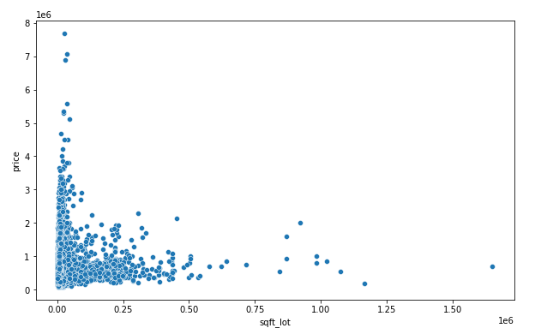
Scatterplot to show distribution of sqft_lot against price

Slide 31
Observation
The sqft_lot and price have a weak positive correlation, therefore an increase in sqft_lot space there is a small noticeable increase in price

Slide 32
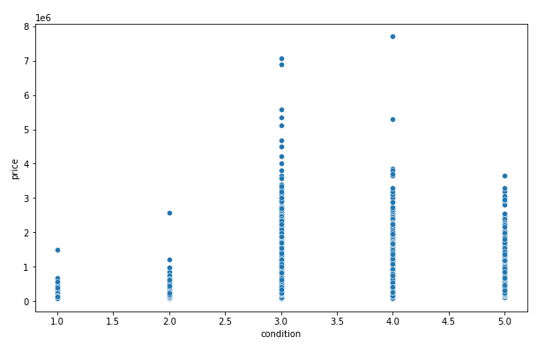
Scatterplot to show distribution of condition against price

Slide 33
Observation
Most houses seem to have a condition of 3 or 4

Slide 34
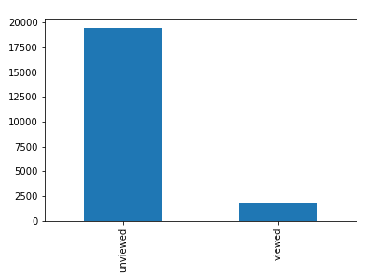
Bins to represent viewed and unviewed houses in the categorical data

Slide 35
Summary
I split the data into categorical and numerical data. In the categorical data I split the view column into viewed, and unviewed category regardless of how many times a house was viewed

Slide 36
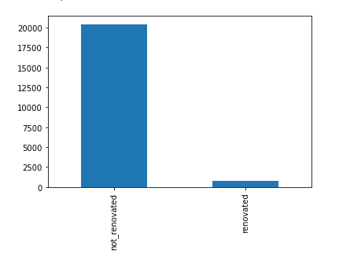
Bins to represent renovated and not_renovated houses in the categorical data

Slide 37
Summary
For the yr_renovated column I split the houses it into renovated and not_renovated category

Slide 38
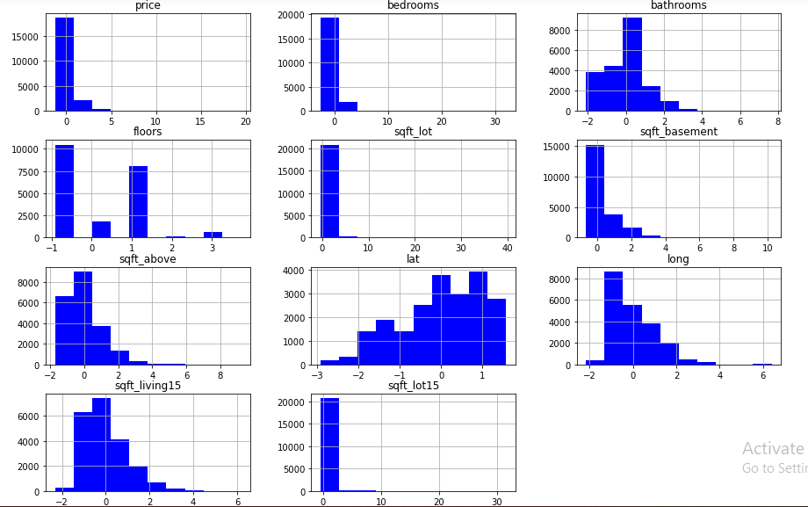
Histogram to represent numerical data after mean-normalization

Slide 39
Observation
After performing mean normalization on the numerical data I came up with the following observations:
sqft_livng15, sqft_above, bathrooms and long seem to be somehow normally distributed compared to the other columns, however, they are positively skewed.
sqft_lot, sqft_basement, floors, sqft_lot15, and price all seem to be positively skewed as the graph tends to lean to the left
lat is the only plot that is negatively skewed

Slide 40
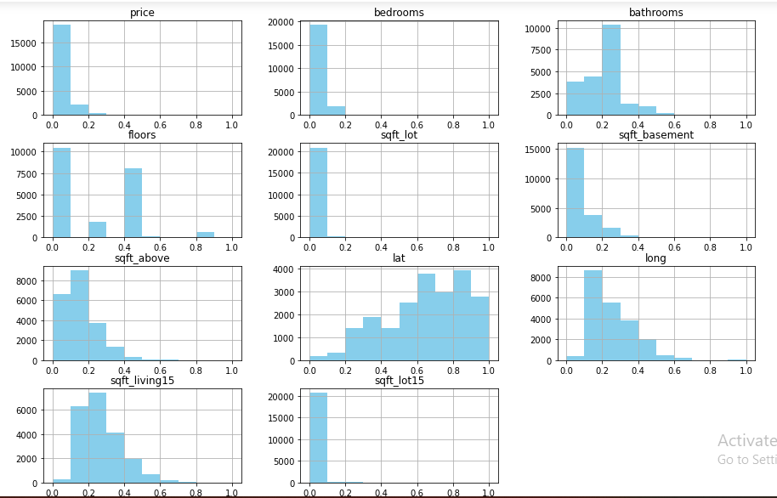
Histogram to represent numerical data after min-max normalization

Slide 41
Observation
After performing min-max normalization on numerical data the observations were the same as the result from mean normalization

Slide 42
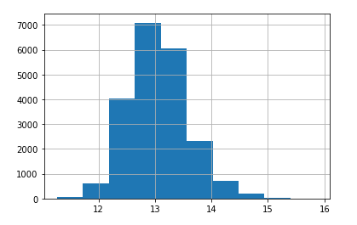
Histogram to show price distribution after log transformation

Slide 43
Observation
We can now say that price is normally distributed in the dataset after performing log transformation on our target variable(price).

Slide 44
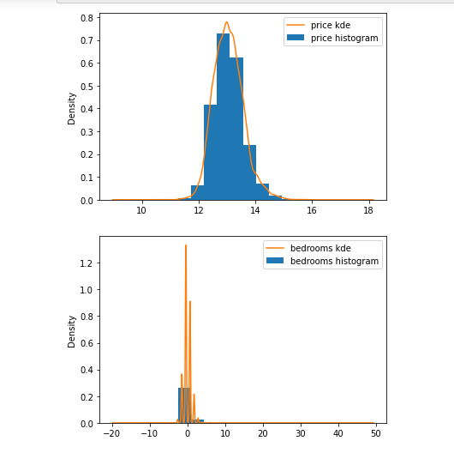
KDE plot to show price and bedroom distribution respectively

Slide 45
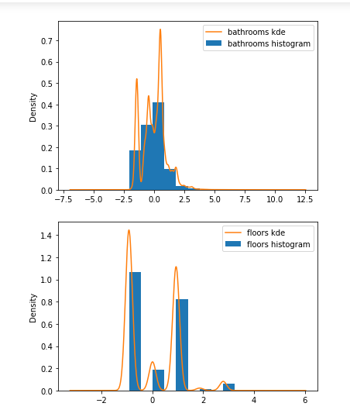
KDE plot to show bathrooms and floors distribution respectively

Slide 46
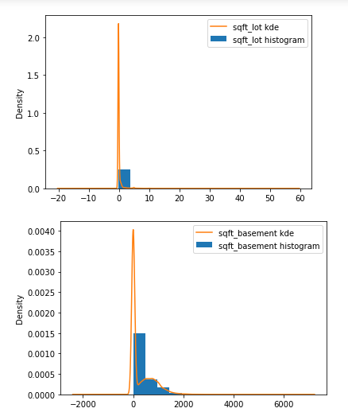
KDE plot to show sqft_lot and sqft_basement distribution respectively

Slide 47
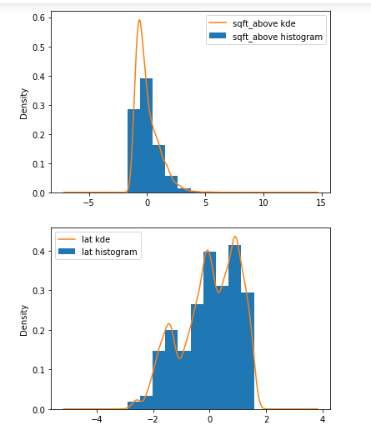
KDE plot to show sqft_above and lat distribution respectively

Slide 48
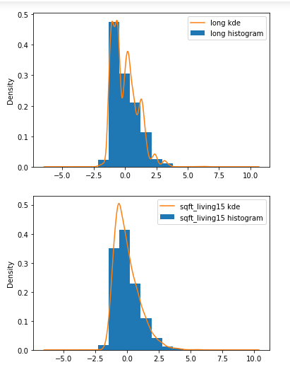
KDE plot to show long and sqft_living15 distribution respectively

Slide 49
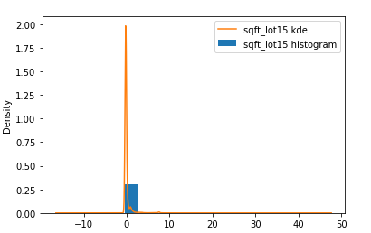
KDE plot to show sqft_lot15 distribution

Slide 50
Summary of KDE plots
The data seems to be a little bit more detailed as compared to the ones illustrated above using histograms. Latitude is still however negatively skewed

Slide 51
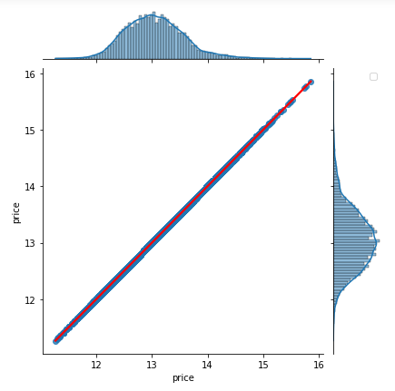
Joint plot to show price distribution

Slide 52
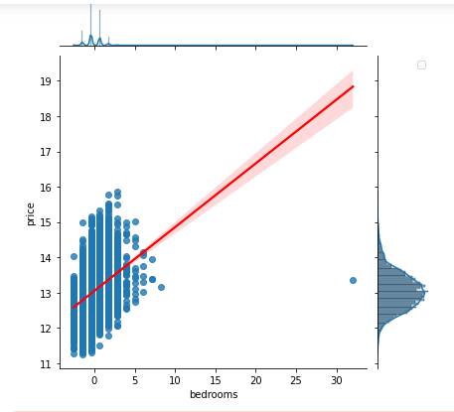
Joint plot to show distribution of bedrooms against price

Slide 53
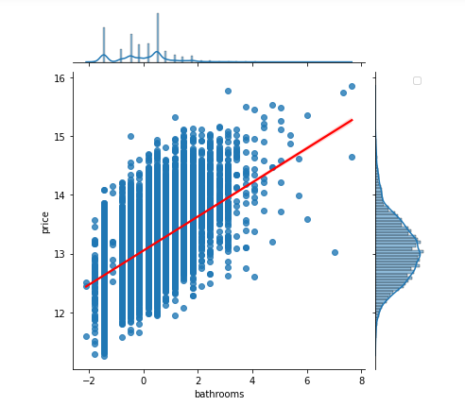
Joint plot to show distribution of bathrooms against price

Slide 54
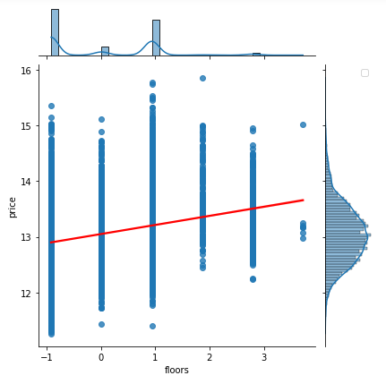
Joint plot to show distribution of floors against price

Slide 55
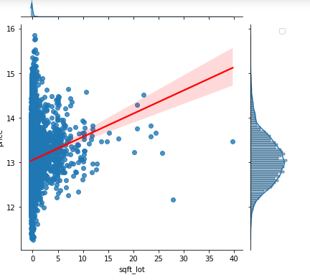
Joint plot to show distribution of sqft_lot against price

Slide 56
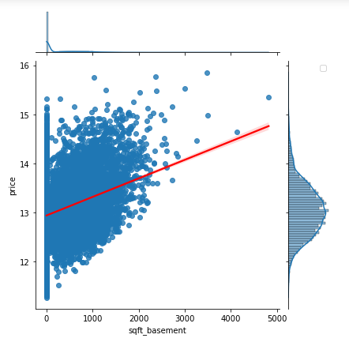
Joint plot to show distribution of sqft_basement against price

Slide 57
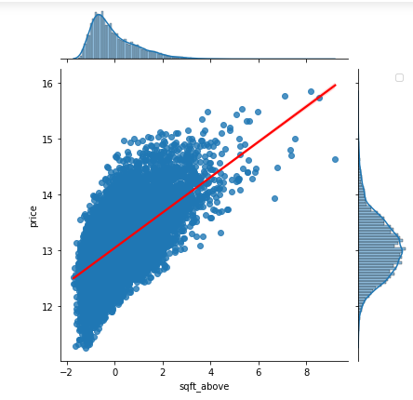
Joint plot to show distribution of sqft_above against price

Slide 58
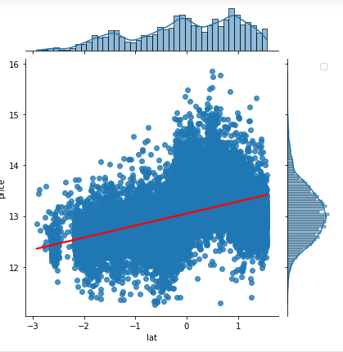
Joint plot to show distribution of lat against price

Slide 59
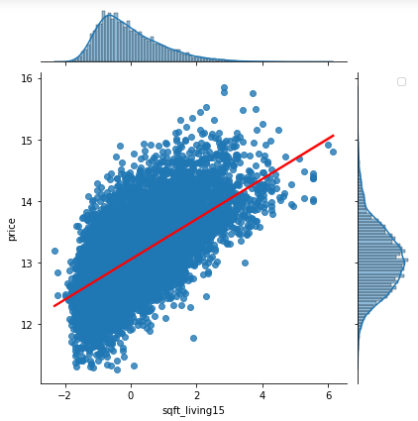
Joint plot to show distribution of sqft_living15 against price

Slide 60
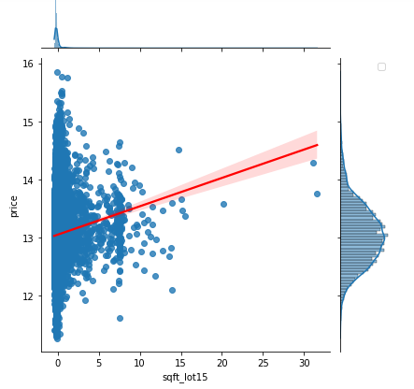
Joint plot to show distribution of sqft_lot15 against price

Slide 61
Summary of jointplots
Most of the variables are positively correlated with price with exception of some like latitude which has a very weak positive correlation with price. An increase in the variable results in an increase in price
House buyers seem to care about Sqft_above because it seems to have the highest slope and has a high positive correlation with price compared to others, which means a slight increase in sqft_above results in a significant increase in price, this was followed by sqft_living15

Slide 62
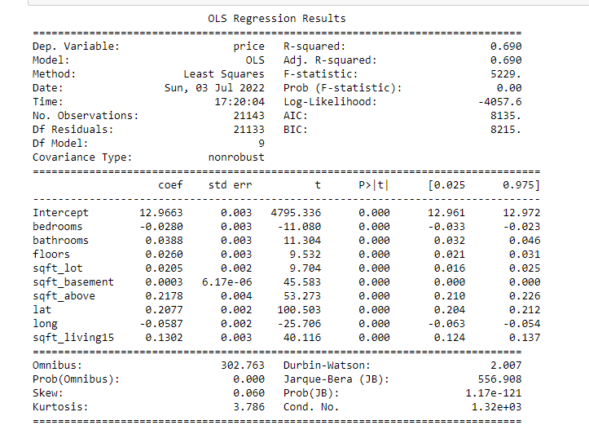
OLS model summary before regression

Slide 63
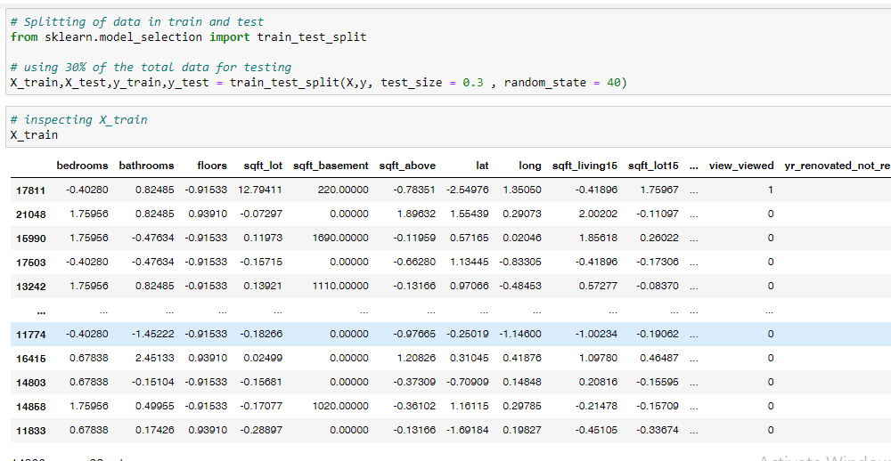
Performing a train-test split on the data

Slide 64
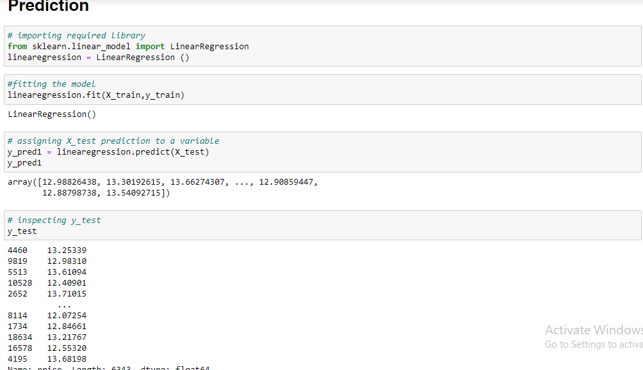
Prediction

Slide 65
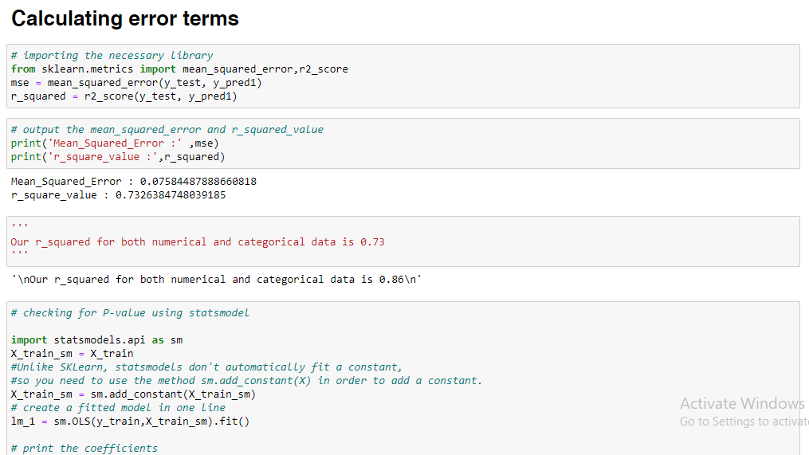
Calculating error terms

Slide 66
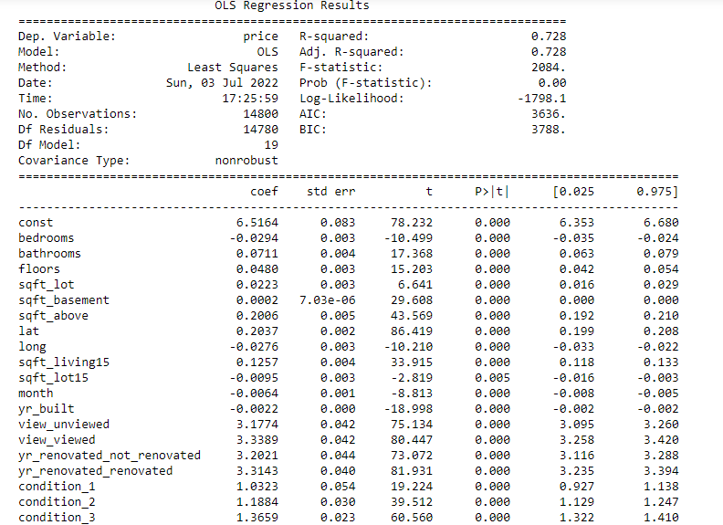
Model summary

Slide 67
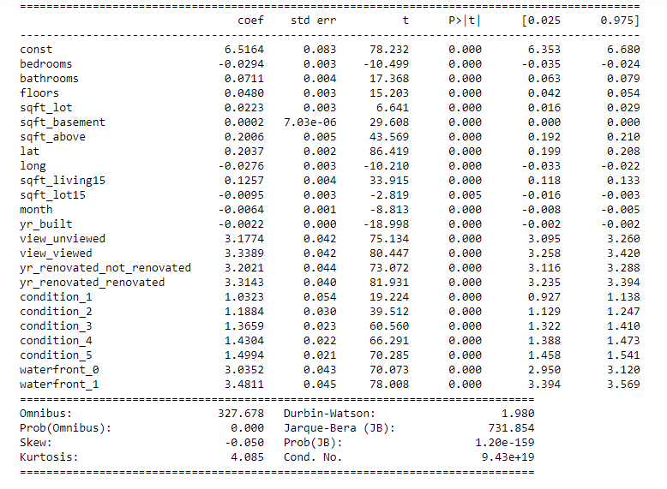
Model summary

Slide 68
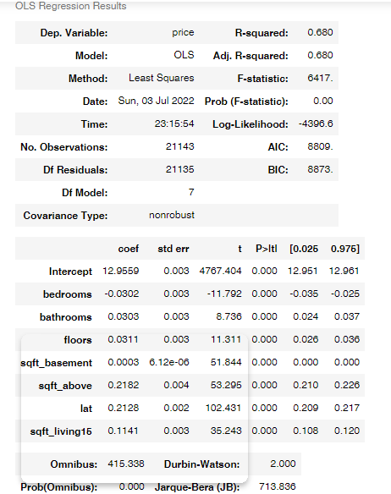
Final model after regression

Slide 69
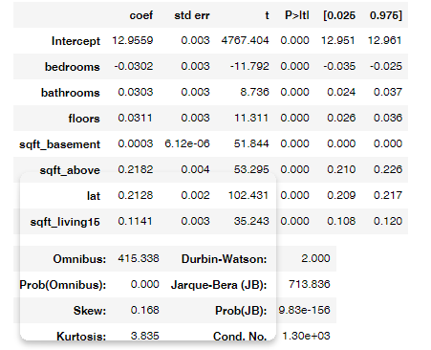
Final model after regression II

Slide 70
Final observation
Most predictors have a positive relationship with price
Sqft-above had the highest slope followed by sqft_living15.
The sqft_above(square footage of house apart from basement) seems to be the one that matters most when it came to price.
A slight increase in sqft_above space there is a significant increase in price.
Sqft_living15 seemed to also be a major aspect of prediction as it has a strong positive relationship with price as we could see in the slope of the joint plot
There was no negative relationship between predictors and target variable
The final model has predictors with a p_value of less than 0.05 and an squared value of 0.7
final prediction variables include sqft_above,sqft_living15,bathrooms,bedrooms,floors,view

